Slide 1
Fig 1. Schematics

Slide 2
Fig 2. Forcing, plus IPCC

Slide 3
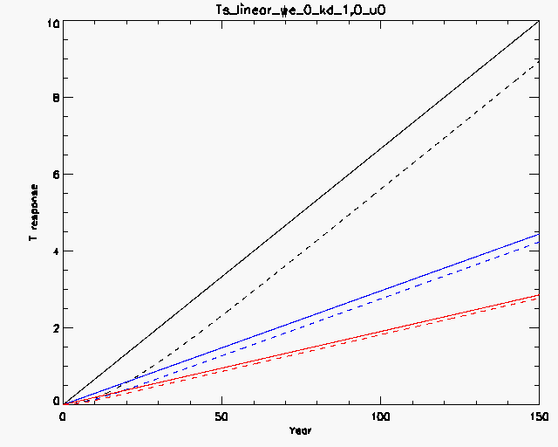
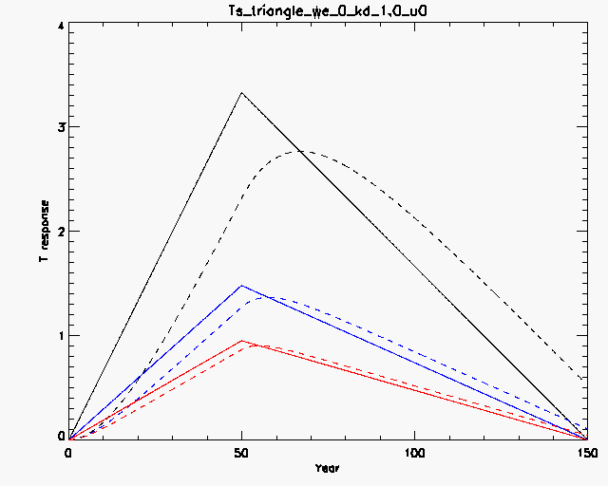
Fig 3. mixed layer response, initial time

Slide 4
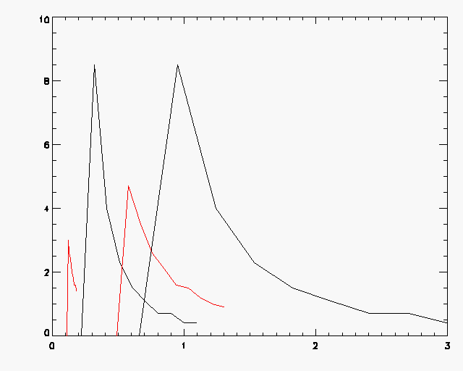
Figure 5 histogram, plus another T for triangle forcing

Slide 5
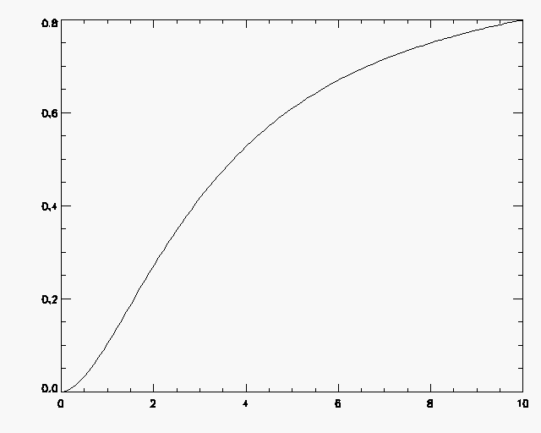
Fig 4. Sensitivity to cloud feedback

Slide 6
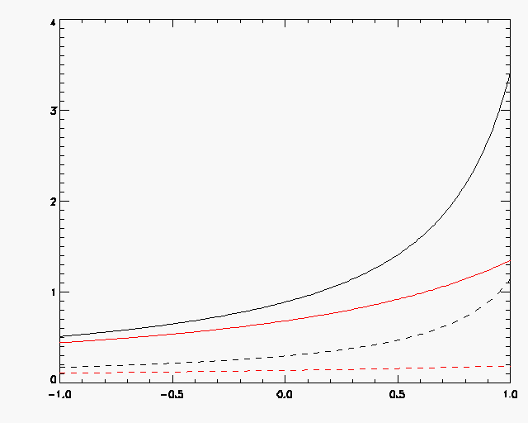
Fig 6. Sensitivity to cloud feedback, Tse and Ts mixed layer

Slide 7
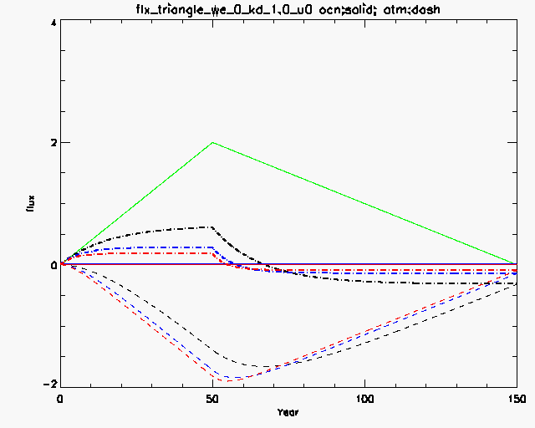
Figure 7

Slide 8
Deep ocean

Slide 9
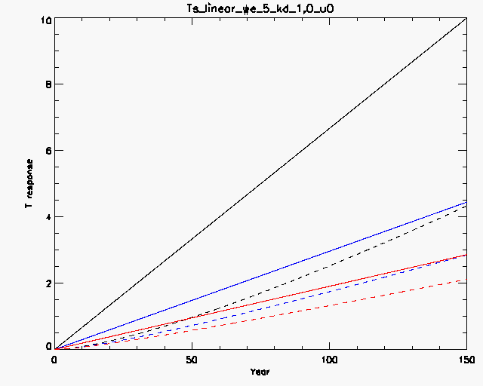
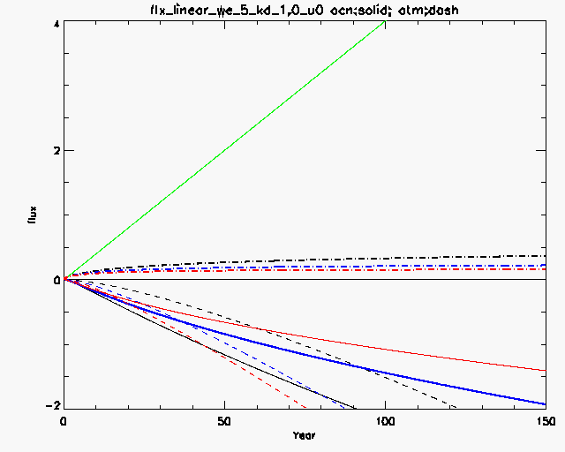
Figure 8
Figure 6 T

Slide 10
A scatter plot of the effective heat capacity?

Slide 11
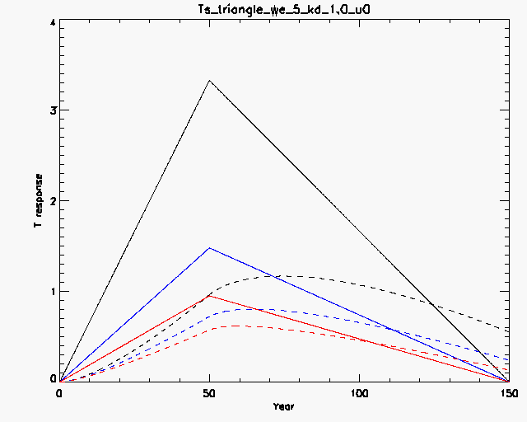
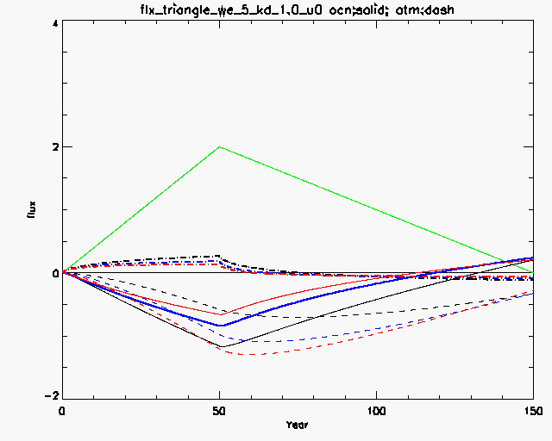
Figure 9

Slide 12
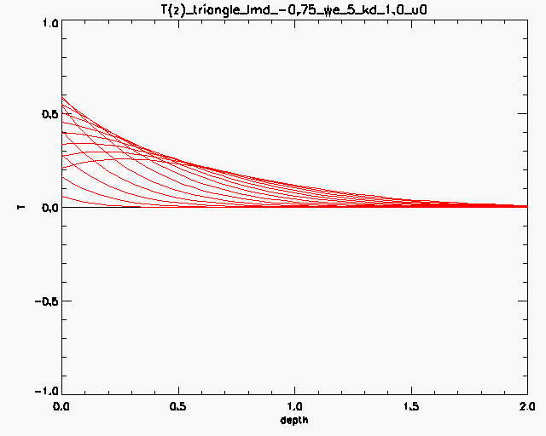
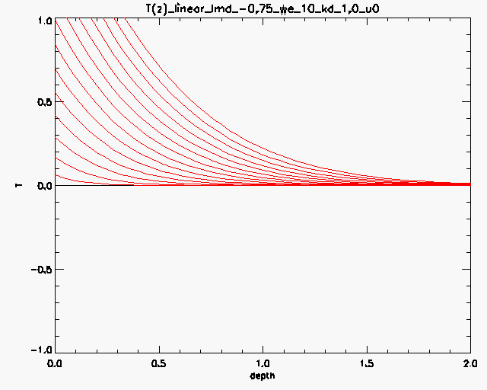
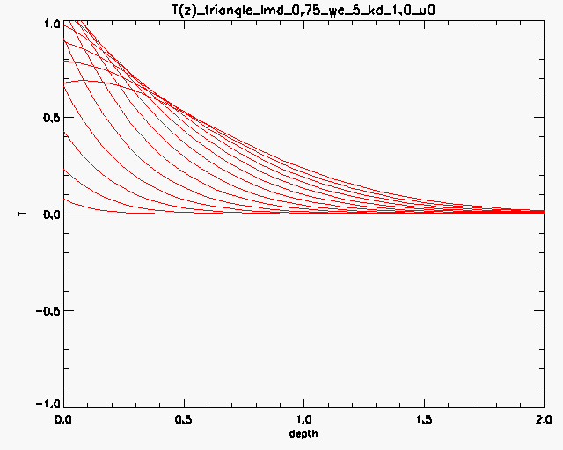
Figure 10

Slide 13
Figure 9 histogram2, for triangle

Slide 14
Sensitivity

Slide 15
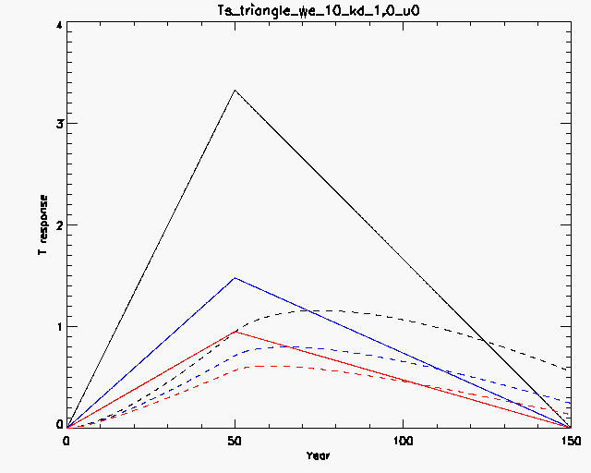
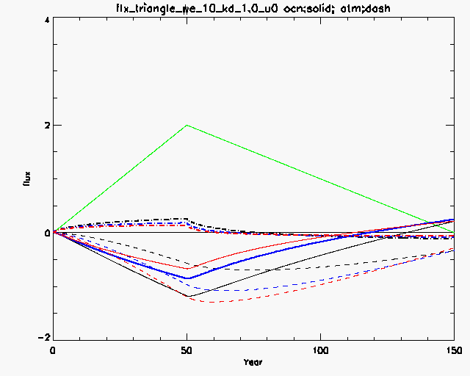
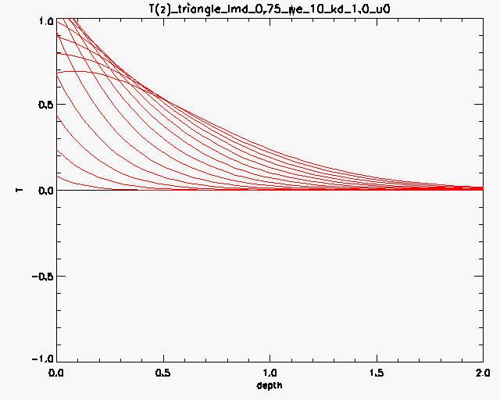

Slide 16
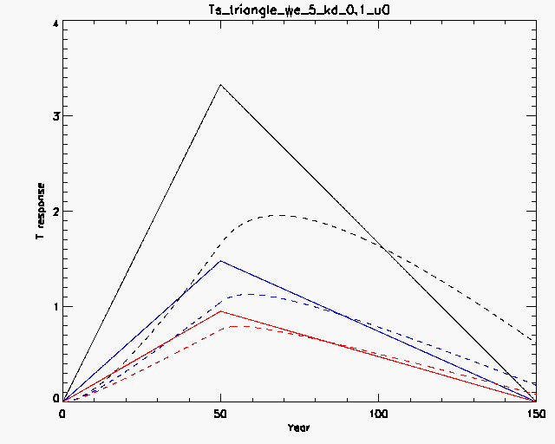
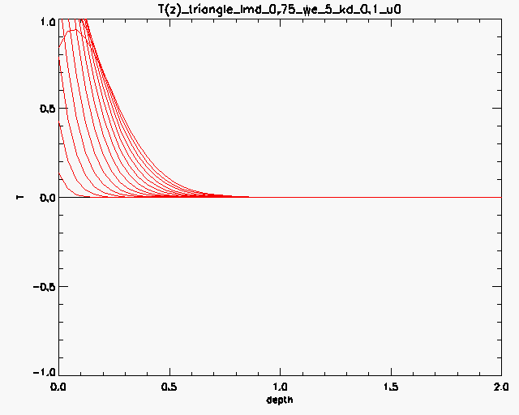
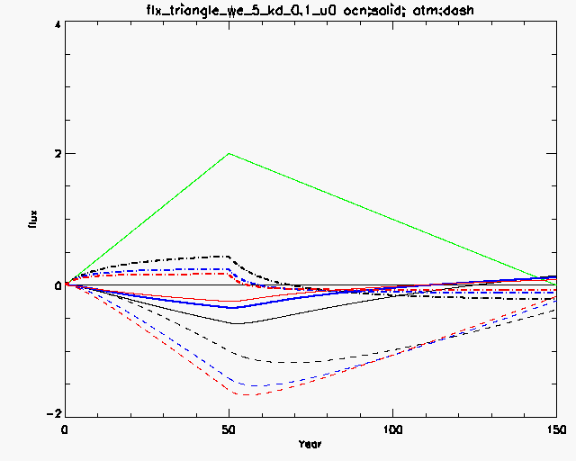
Figure 9

Slide 17
Sensitivity to u and discussions, re-calculate to reduce u

Slide 18
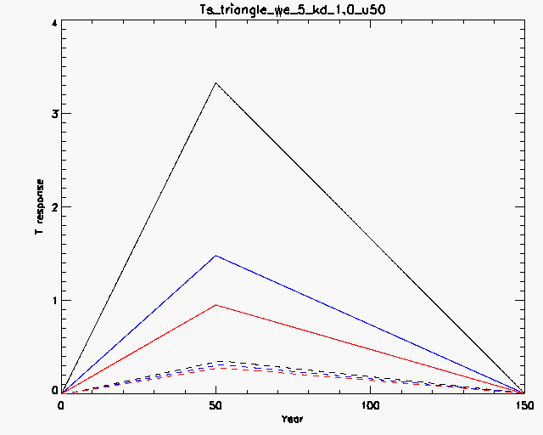
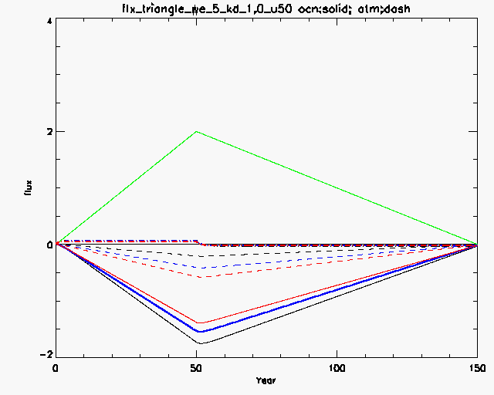
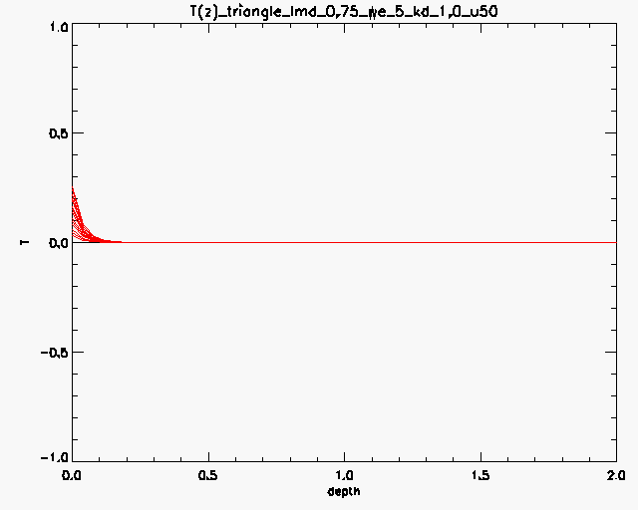

Slide 19
Figure histogram3, plus another T for triangle forcing
Make u smaller!

